Slide 1
Lesson #2 : Practical Machine LEarning

Slide 2
Practical machine learning:
Learning objectives for today
After today’s class, you should be able to
Describe the Standard (Textbook) Machine Learning Pattern
Determine where the Standard Textbook Pattern fails
Describe often Overlooked Factors that impact the Standard Pattern
Define common Terminology used in talking about Machine Learning Performance
Justify where iteration is most important in machine learning
Describe one fundamental technical problem in Human-AI interaction, and why it is difficult to solve
Think it through
Make it through
Teach it through

Slide 3

Machine Learning
A “machine” that is able to improve based on past experience without explicit human programming on how to improve each time.
"A computer program is said to learn from experience E with respect to some class of tasks T and performance measure P if its performance at tasks in T, as measured by P, improves with experience E."
-- Tom M. Mitchell

Slide 4
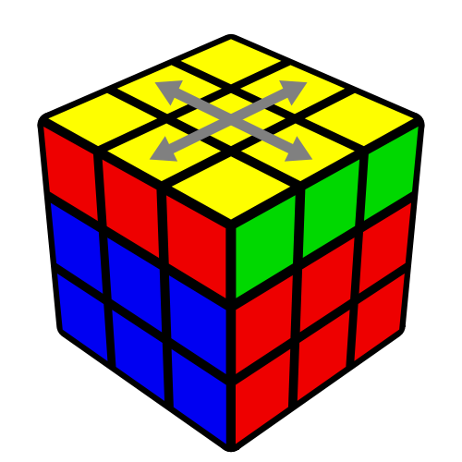
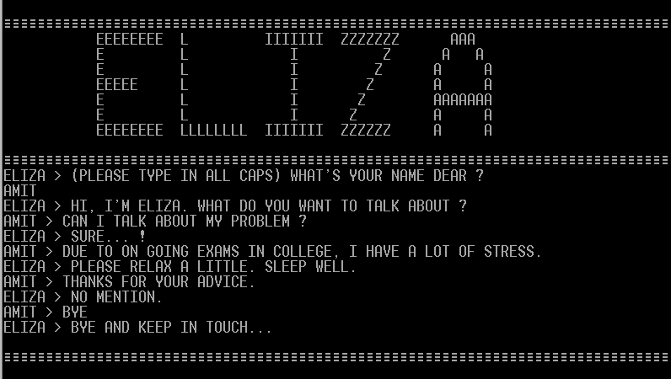
Reminder: AI That Isn’t Machine Learning
Search-Based Approaches
A* search, for instance
Many early approaches for solving games
Expert Systems
hand-coded rules and logic
“learn” by humans adding more rules
(originally) Search Engines
early work focused on systems
1966, Joseph Weizenbaum

Slide 5
Machine Learning
"A computer program is said to learn from experience E with respect to some class of tasks T and performance measure P if its performance at tasks in T, as measured by P, improves with experience E."
-- Tom M. Mitchell
Experience: Data Task: Prediction (classification, recommendation, NL gen, etc.) Performance: Accuracy (etc.)

Slide 6

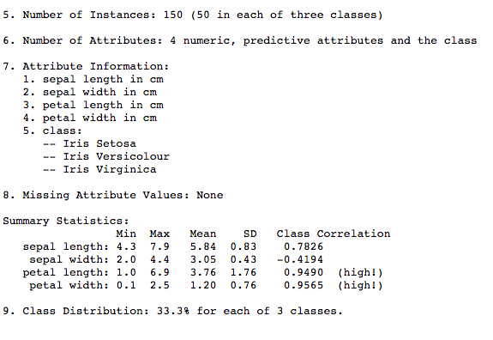
Standard Machine Learning Pattern
Iris Dataset, UCI Machine Learning Repository
https://archive.ics.uci.edu/ml/datasets/iris
Training Data (experience)
Machine Learning Algorithm
(task)
New Example
Model
??
Notes:
The standard machine learning pattern that you learn in machine learning courses, goes something like this: You are given some data. This usually comes in the form of multiple examples of some things or observations. Each example has some value for each of a number of features.
In a training phase, you feed in some or all of this data into a machine learning algorithm. This class is not the class where you’ll learn how these machine learning algorithms work. Understanding the basics of how they work, which sort of algorithm is important for different kinds of problems, is important. But, it’s not all that important for the purposes of this lecture, or really for the goals of this class. What’s important is that you have some data, and this machine learning algorithm was created to try to learn from these past examples how to predict something about future ones.
Machine learning algorithms won’t ever be perfect -- sometimes they’ll not work well, and sometimes they’ll even be pretty stupid. As a result, an important part of this process is evaluation. How do we know whether our machine learning algorithm is doing a good job on the task that we gave it, and most importantly how do we know whether it’s likely to do a good job out in the real world on new examples it’s really never seen before?

Slide 7
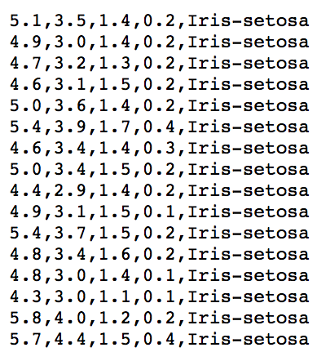
Standard Machine Learning Pattern
Iris Dataset, UCI Machine Learning Repository
https://archive.ics.uci.edu/ml/datasets/iris
Training Data (experience)
Machine Learning Algorithm
(task)
New Example
Model
??
Notes:
So the data looks like this. This is an old dataset and a tiny one.

Slide 8
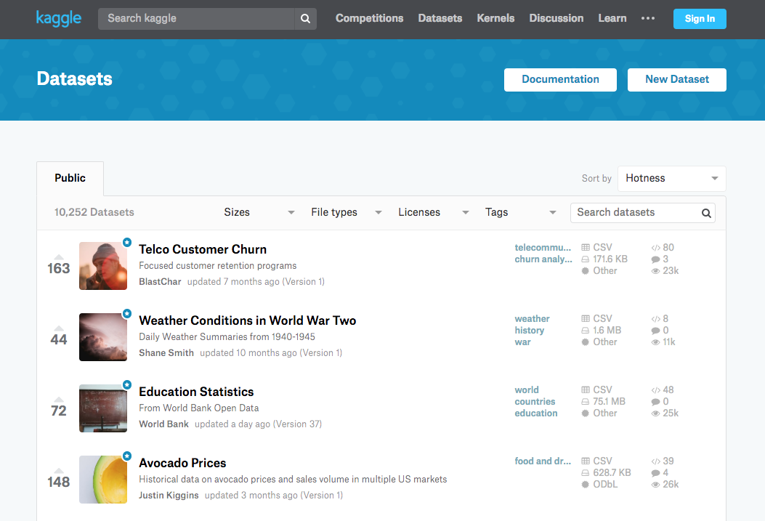

Slide 9


Slide 10
2. Terminology:
Machine learning tasks
Classification
Is this a dog or a cat?
Regression
How warm will it be tomorrow?
Clustering
Here are a few articles. Organize them into topics
Representation
What is the best way to represent words? (e.g. so representation of “autumn” and “fall” are similar)
What is the color of happiness?
“Dear algorithm: figure it out, and if you’re right, you get a reward”
Drive a car
Recommend movies to people
“Dear algorithm: figure it out, and if you’re right, you get a reward”
Drive a car
Recommend movies to people

Slide 11
Machine learning tasks
Classification
Is this a dog or a cat?
Regression
How warm will it be tomorrow?
Clustering
Here are a few articles. Organize them into topics
Representation
What is the best way to represent words? (e.g. so representation of “autumn” and “fall” are similar)
What is the color of happiness?
“Dear algorithm: figure it out, and if you’re right, you get a reward”
Drive a car
Recommend movies to people
Supervised learning
Unsupervised learning
Reinforcement learning

Slide 12
Machine learning tasks
Supervised learning
Weakly supervised,
transfer learning
Unsupervised learning
Contextual reinforcement learning
Reinforcement learning

Slide 13
Difference between supervised and reinforcement learning
In reinforcement learning, the data you collect depends on your previous actions
If you show an ad, you get to see if the user clicks on it
But you don’t get to see if the user may also have clicked on a different ad if you had shown that instead
One way to measure the performance of your reinforcement learning algorithm is to use “regret”:
How much do you lose compared to the best solution?
e.g. if you knew exactly what the user wanted, what ads would you show them?

Slide 14
2. Terminology: Evaluation
What metrics do we use to discuss performance?
How do we set up a meaningful evaluation?
Notes:
How do we think about evaluation of models?

Slide 15
Evaluation Metrics
We’re generally interested in the following:
How often is the prediction wrong?
How is the prediction wrong?
What is the cost of wrong predictions?
How does the cost vary by the type of prediction that was wrong?
How can we minimize cost? (or regret?)

Slide 16
Accuracy
correct predictions/total predictions

Slide 17

Accuracy in Speech Recognition
Does this match your experience?

Slide 18

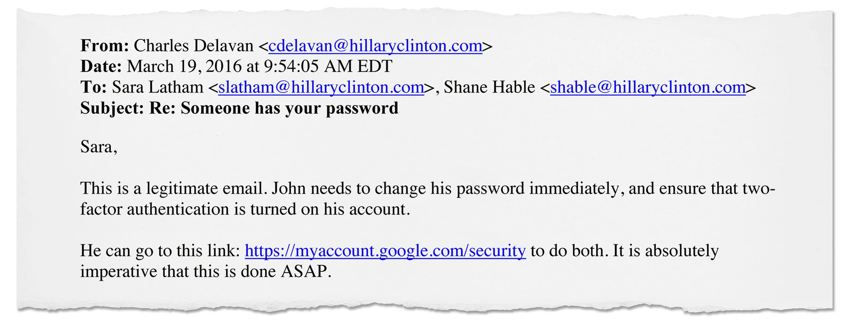
a “98% accurate” spam filter
From the Guardian: https://www.theguardian.com/us-news/2016/dec/14/dnc-hillary-clinton-emails-hacked-russia-aide-typo-investigation-finds and NYT: https://www.nytimes.com/2016/12/13/us/politics/russia-hack-election-dnc.html?hp&action=click&pgtype=Homepage&clickSource=story-heading&module=a-lede-package-region&region=top-news&WT.nav=top-news

Slide 19
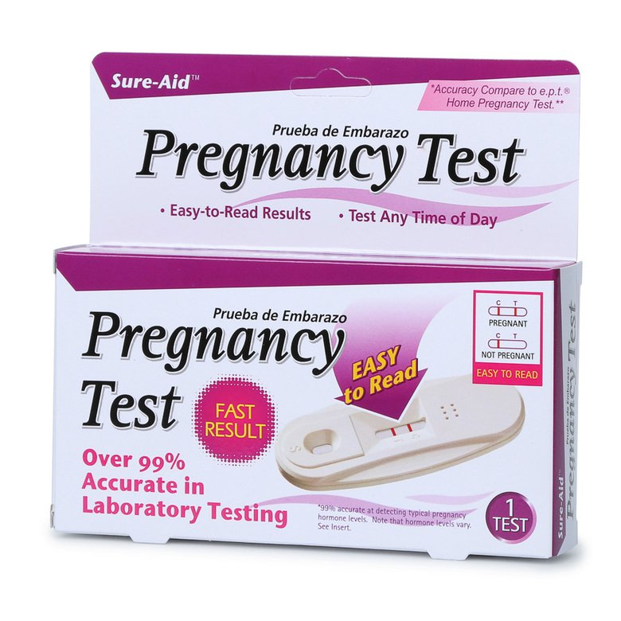
Why Accuracy isn’t enough.
For many problems, it is *easy* to produce accurate models.

Slide 20
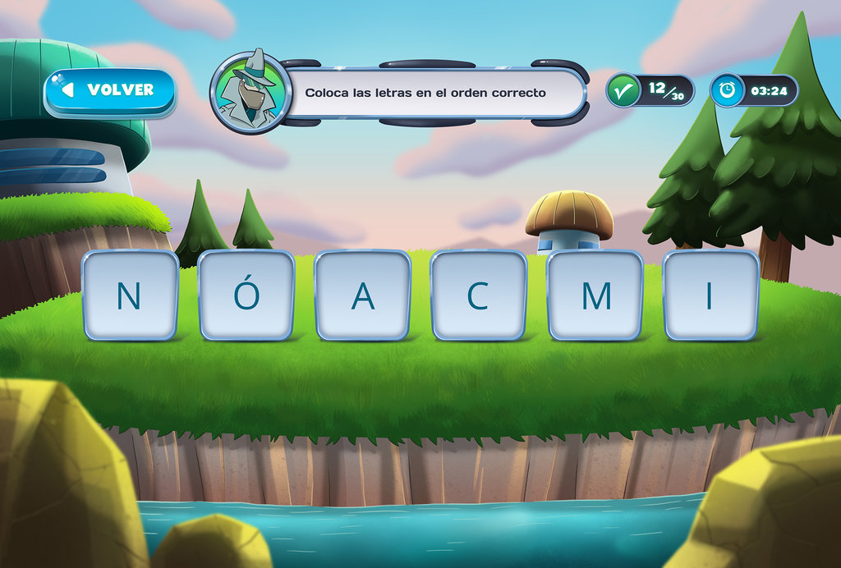
Dyslexia Detection
~10-15% of people have dyslexia
hidden disability, hard to detect
http://www.changedyslexia.org

Slide 21


Slide 22
Dyslexia Detection
~10-15% of people have dyslexia
hidden disability, hard to detect
http://www.changedyslexia.org

Slide 23
Metrics: What do we measure?
What can happen when your model classifies something.
Prediction
 | dyslexia (T) | non-dyslexia (F)
dyslexia | true positive | false negative
non-dyslexia | false positive | true negative
Ground
Truth

Slide 24
Metrics: What do we measure?
What can happen when your model classifies something.
Prediction
 | dyslexia | non-dyslexia
dyslexia | 0.95 | 0.05
non-dyslexia | 0.25 | 0.75
Ground
Truth

Slide 25
Metrics: What do we measure?
What can happen when your model classifies something (e.g. do you have the flu?)
Prediction
 | Infected (T) | Healthy (F)
Infected | true positives | false negative
Healthy | false positives | true negative
Ground
Truth

Slide 26
Metrics: Terminology
False Positive, False Positive Rate
False Negative, False Negative Rate
Sensitivity == True Positive Rate
ability of the test to identify those who have a disease
Specificity == True Negative Rate
ability of the test to identify those without the disease

Slide 27
All Errors Are Not Equal
Depending on your task, different errors have different costs.
Cost of “false negative” in pregnancy detection? Cost of “false positive” in pregnancy detection?
In law enforcement?
In detecting the “Alexa” command? In detecting person in the road?

Slide 28
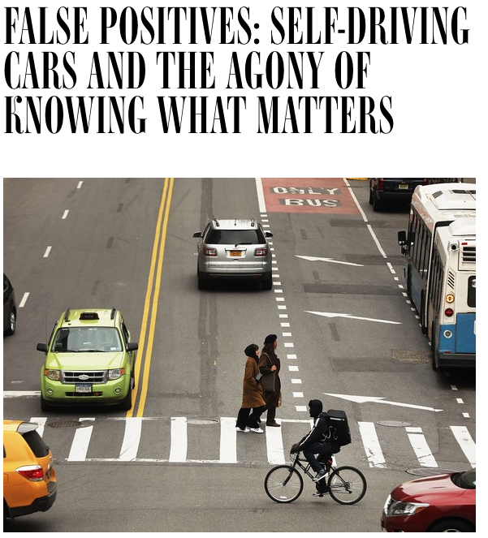
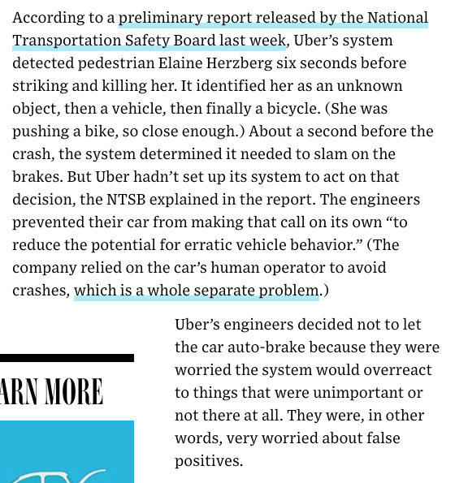
https://www.wired.com/story/self-driving-cars-uber-crash-false-positive-negative/

Slide 29
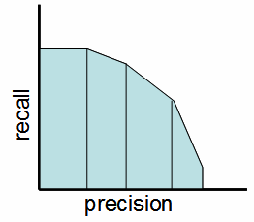
Metrics: Precision and Recall
Often used in information retrieval.
Precision = true positives / (true positives + false positives)
Recall = true positives / (true positives + false negatives)

Slide 30

Metrics: Precision and Recall
Often used in information retrieval.
Precision = true positives / (true positives + false positives)
Recall = true positives / (true positives + false negatives)

Slide 31
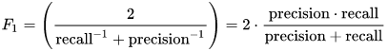
Metrics: F1 score
Often used in information retrieval
The harmonic mean of precision and recall.
What is the implicit assumption about the costs of errors?

Slide 32
Silent errors
Not all errors are visible to the computer
How do you measure when your device can’t hear “OK, Google”

Slide 33
The “standard textbook model”
Training Data (experience)
Machine Learning Algorithm
(task)
New Example
Model
??

Slide 34
Setting Up Meaningful Evaluations
Avoiding Overfitting
Easy for models to learn their own training data

Slide 35
Train, Test, and Validate
Data
Training
Training
Training
Training
Test
Validation
Test
Test

Slide 36
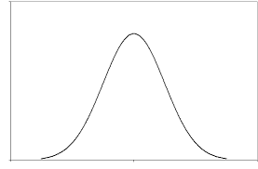
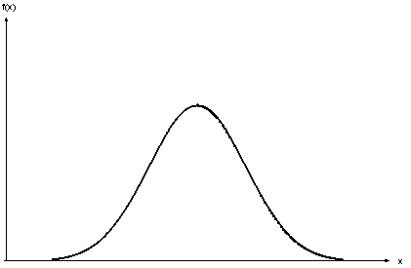
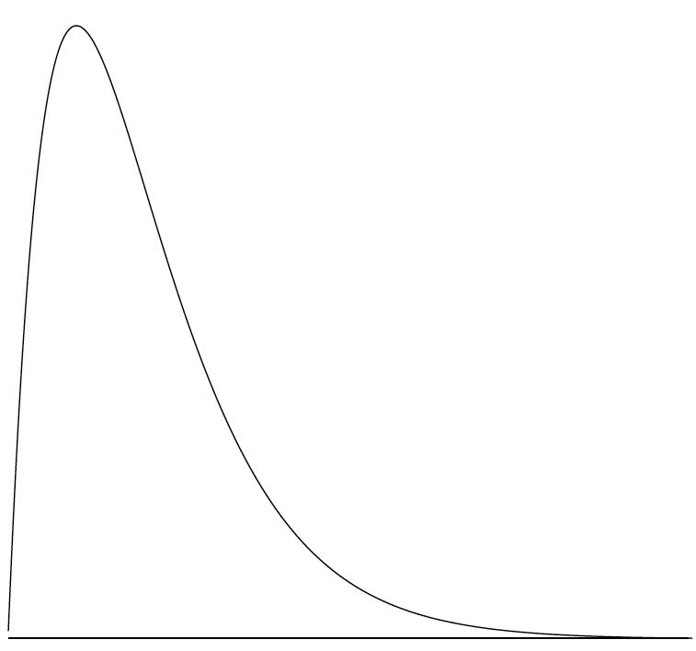
Train, Test, and Validate
Data
Training
Training
Training
Training
Test
Test
Test
Training

Slide 37

What kind of error is this?

Slide 38

https://www.economist.com/books-and-arts/2018/02/15/in-the-world-of-voice-recognition-not-all-accents-are-equal

Slide 39
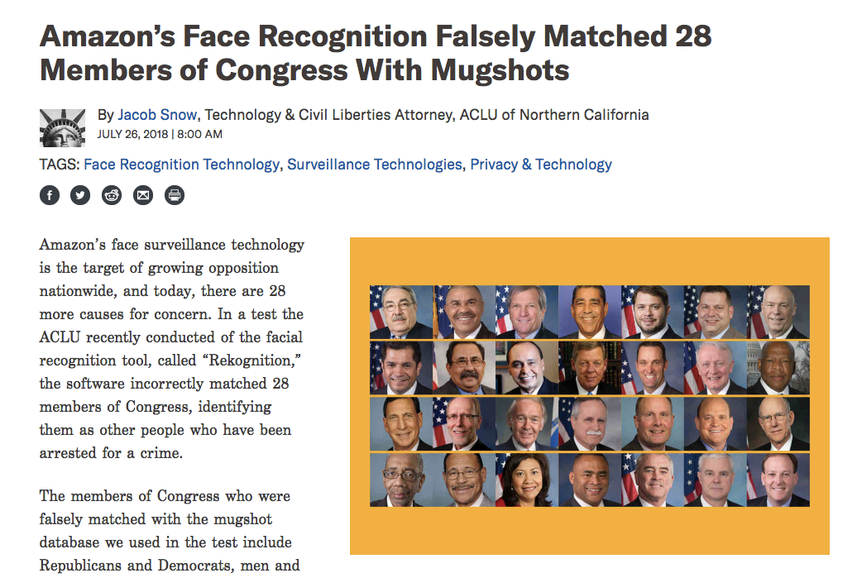
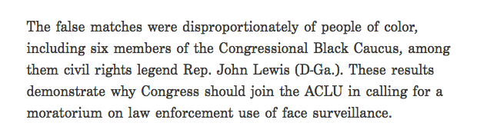

Slide 40
Jumping out a level…
The flip side of overfitting… failure to generalize, failure to adapt:
What happens when your model goes out into the world?

Slide 41
The Unquestioned Textbook Assumption
Training Data (experience)
This is not fixed!
Machine Learning Algorithm
(task)
Who chose this, and why?
New Example
Model
??

Slide 42


Iterative not Waterfall
everything can and should be iterated on, including the problem itself … what are you trying to solve?
Training Data (experience)
Machine Learning Algorithm
(task)
New Example
Model
??
Notes:
iteration, and not just on the model, or even the data, although both are important.
We need to iterate to find good problems.

Slide 43
Start at the End …
Training Data (experience)
Machine Learning Algorithm
(task)
New Example
Model
??
Notes:
iteration, and not just on the model, or even the data, although both are important.
We need to iterate to find good problems.

Slide 44
Connection to Direct Manipulation
Continuous Representation of Object of Interest (feedback)
Rapid, incremental, and reversible interactions
Physical Actions

Slide 45
Connection to Direct Manipulation (Agents)
Continuous Representation of Object of Interest (feedback)
* agents: continuous representation not possible
Rapid, incremental, and reversible interactions
* agents: doesn’t know how it got there, can’t go back
Physical Actions
* agents: tendency to force the unexpected

Slide 46
Summary
Building Human-AI Systems is Iterative
resist the “Pipeline” metaphor
Terminology and Way of Thinking About Performance/Errors
these apply regardless of what you stick in the black box
HCI for AI is fundamentally about dealing w/ uncertainty and errors
everything we will talk about in this course

